Slide 1
Parameter passing techniques
L24-L25

Slide 2
Objectives
To learn and appreciate the following concepts
Parameter passing techniques
Pass by value
Pass by reference

Slide 3
Session outcome
At the end of session one will be able to understand
The overall ideology of parameter passing techniques

Slide 4
Parameters/Arguments
Functions-Overview
void dispChar(int n, char c);//proto-type declaration
Formal parameters
void dispChar(int n, char c) // function definition
{
cout<<" You have entered "<< n<< “&” <<c;
}
void main(){ //calling program
int no; char ch;
cout<<"\nEnter a number & a character: \n";
cin>>no>>ch;
dispChar( no, ch); //Function reference
}
Actual parameters
Notes:
Additional information on arguments and parameters
These two terms parameter and argument are sometimes loosely used interchangeably, and the context is used to distinguish the meaning. The term parameter (sometimes called formal parameter) is often used to refer to the variable as found in the function definition, while argument (sometimes called actual parameter) refers to the actual value passed. To avoid confusion, it is common to view a parameter as a variable, and an argument as a value.
Parameters appear in procedure definitions; arguments appear in procedure calls. In the function definition f(x) = x*x the variable x is a parameter; in the function call f(2) the value 2 is the argument of the function. Loosely, a parameter is a type, and an argument is an instance.
A parameter is an intrinsic property of the procedure, included in its definition. For example, in many languages, a procedure to add two supplied integers together and calculate the sum would need two parameters, one for each integer. In general, a procedure may be defined with any number of parameters, or no parameters at all. If a procedure has parameters, the part of its definition that specifies the parameters is called its parameter list.
By contrast, the arguments are the values supplied to the procedure when it is called. Unlike the parameters, which form an unchanging part of the procedure's definition, the arguments may vary from call to call. Each time a procedure is called, the part of the procedure call that specifies the arguments is called the argument list.
Although parameters are also commonly referred to as arguments, arguments are more properly thought of as the actual values or references assigned to the parameter variables when the subroutine is called at run-time. When discussing code that is calling into a subroutine, any values or references passed into the subroutine are the arguments, and the place in the code where these values or references are given is the parameter list. When discussing the code inside the subroutine definition, the variables in the subroutine's parameter list are the parameters, while the values of the parameters at runtime are the arguments.

Slide 5
Functions- Parameter Passing
Pass by value (call by value)
Pass by reference (call by reference)
Notes:
Analogy example illustration
If I tell you the URL, I'm passing by reference. You can use that URL to see the same web page I can see. If that page is changed, we both see the changes. If you delete the URL, all you're doing is destroying your reference to that page - you're not deleting the actual page itself.
If I print out the page and give you the printout, I'm passing by value. Your page is a disconnected copy of the original. You won't see any subsequent changes, and any changes that you make (e.g. scribbling on your printout) will not show up on the original page. If you destroy the printout, you have actually destroyed your copy of the object - but the original web page remains intact.

Slide 6
Pass by value
void swap(int x, int y ){
int t=x;
x=y;
y=t;
cout<<"\nIn fn: x= "<<x <<" & y= "<<y;
}
void swap(int , int); // prototype
void main(){
int a=5,b=7;
swap(a, b);
cout<<"\nAfter swap: a= " <<a <<" & b= "<<b;
}
Output:
In fn: x = 7 & y = 5
After swap: a = 5 & b = 7
Notes:
Notes on
Call by Value
If data is passed by value, the data is copied from the variable used in for example main() to a variable used by the function. So if the data passed (that is stored in the function variable) is modified inside the function, the value is only changed in the variable used inside the function.
Call by Reference
If data is passed by reference, a pointer to the data is copied instead of the actual variable as is done in a call by value. Because a pointer is copied, if the value at that pointers address is changed in the function, the value is also changed in main().
When to Use Call by Value and When to use Call by Reference?
One advantage of the call by reference method is that it is using pointers, so there is no doubling of the memory used by the variables (as with the copy of the call by value method). This is of course great, lowering the memory footprint is always a good thing. So why don’t we just make all the parameters call by reference?
There are two reasons why this is not a good idea and that you (the programmer) need to choose between call by value and call by reference. The reason are: side effects and privacy. Unwanted side effects are usually caused by inadvertently changes that are made to a call by reference parameter. Also in most cases you want the data to be private and that someone calling a function only be able to change if you want it. So it is better to use a call by value by default and only use call by reference if data changes are expected.

Slide 7
Pass by Reference
void swap(int &x, int &y ){
int t=x;
x=y;
y=t;
}
Using alias name for the variable.
Value assignment is done to actual variables a & b using alias names x & y.
void swap(int &, int & ); // prototype
void main(){
int a=5,b=7;
swap(a, b);
cout<<"\nAfter swap are: a= " <<a <<" & b= "<<b;
}
Output:
a = 7 & b = 5
Notes:
Notes
Advantages of passing by reference:
It allows us to have the function change the value of the argument, which is sometimes useful.
Because a copy of the argument is not made, it is fast, even when used with large structs or classes.
We can pass by constant reference to avoid unintentional changes.
We can return multiple values from a function.
Disadvantages of passing by reference:
Because a non-constant reference can not be made to a literal or an expression, reference arguments must be normal variables.
It can be hard to tell whether a parameter passed by reference is meant to be input, output, or both.
It’s impossible to tell from the function call that the argument may change. An argument passed by value and passed by reference looks the same. We can only tell whether an argument is passed by value or reference by looking at the function declaration. This can lead to situations where the programmer does not realize a function will change the value of the argument.
Because references are typically implemented by C++ using pointers, and dereferencing a pointer is slower than accessing it directly, accessing values passed by reference is slower than accessing values passed by value.

Slide 8
Pass by Reference
void swap(int *x, int *y); // prototype
void main(){
int a=5,b=7;
swap(&a, &b);
cout<<"\nAfter swap are: a= " <<a <<" & b= "<<b;
}
Output:
a = 7 & b = 5
void swap(int *x, int *y ){
int t=*x;
*x=*y;
*y=t;
}

Slide 9
Pass by Reference
We use two operators to achieve parameter passing by reference.
address operator ‘&’ and
indirection operator ‘*’
Here
The actual arguments (arguments in function call) are input arguments and
The formal arguments (those in function definition) are output arguments.
How its working!
In the fn call when we pass the actual values to function, we pass the address of locations where the values are stored in the memory (thus the & is called address operator).
The operator * is known as indirection operator because it gives an indirect reference to a variable through its address stored in it.

Slide 10
Pass by Reference
void swap(int *x, int *y ){
int t=*x;
*x=*y;
*y=t;
}
Change is directly on the variable using the reference to the address.
When function is called:
address of a → x
address of b → y
void swap(int *, int *); // prototype
void main(){
int a=5,b=7;
swap(&a, &b);
cout<<"\nAfter swap are: a= " <<a <<" & b= "<<b;
}
Output:
a = 7 & b = 5

Slide 11
Pass by Reference
The variables *x and *y are known as pointers (will see in detail later) and x and y are the pointer variables.
The use of pointer variables as actual parameters for communicating data between functions is called pass by pointers or call by address or call by reference.
Rules for pass by reference
Types of actual arguments and formal arguments must be same.
Actual arguments must be the addresses of variables that are local to calling function.
Formal arguments in the function header must be prefixed by indirection operator (*).
In the prototype, the arguments must be prefixed by *.
To access the value of an actual argument in the called function, we must use corresponding argument prefixed with *.

Slide 12
Fn that return multiple values
Using pass by reference (1st Method) we can achieve fn that return multiple values.
void fnOpr(int a, int b, int &sum, int &diff) {
sum = a + b;
diff = a -b; }
void main() {
void fnOpr(int , int , int &, int &);
int x, y, s, d;
cout<<"\nEnter the values: \n";
cin>>x>>y;
fnOpr(x, y, s, d);
cout<<"\nResults are \n"<<"Sum = "<<s<<"Diff = "<<d;
}
Output:
x= 5 & y= 3
s =8 & d = 2

Slide 13
Function that return multiple values
Using pass by reference we can achieve function that return multiple values.
void fnOpr(int a, int b, int *sum, int *diff) {
*sum = a + b;
*diff = a -b; }
void main() {
void fnOpr(int , int , int *, int *);
int x, y, s, d;
cout<<"\nEnter the values: \n";
cin>>x>>y;
fnOpr(x, y, &s, &d);
cout<<"\nResults are \n"<<"Sum = "<<s<<"Diff = "<<d;
}
Output:
x= 5 & y= 3
s =8 & d = 2

Slide 14
Nesting of Functions
Functions can be used inside another function.
void fnOpr(int a, int b, int *sum, int *diff) {
*sum = a + b;
if (fnDiff(a,b))
*diff = a -b;
else
*diff = b - a; }
int fnDiff(int p, int q){
if (p>q)
return(1);
else
return (0);}
void main() {
int x, y, s, d;
cout<<"\nEnter the values: \n";
cin>>x>>y;
fnOpr(x, y, &s, &d);
cout<<"\nThe results are \n"<<"Sum = "<<s<<"\n"<<"Diff = "<<d; }
Output:
x= 3 & y= 5
s =8 & d = 2

Slide 15
Passing 1D-Array to Function
int fnParr( int a[ ], int n) {
int sum=0;
for(int i=0;i<n;i++)
sum+=a[i];
return (sum); }
Output: n=5
1, 2, 3, 4, 5
Sum of elements = 15
void main() {
int n, a[20], x, y;
int fnParr(int a[ ], int n); //prototype
cout<<"\nEnter the limit \n";
cin>>n;
cout<<"\nEnter the values: \n";
for (int i=0; i<n; i++)
cin>>a[i];
cout<<"\nThe sum of array elements is: "<<fnParr(a, n); //fn call}

Slide 16
Passing 1D-Array to Function
Rules to pass an array to a function
The function must be called by passing only the name of the array.
In the function definition, the formal parameter must be an array type; the size of the array does not need to be specified.
The function prototype must show that argument is an array.

Slide 17
Passing 1D-Array to Function
int fnParr( int a[ ], int n) {
int sum=0;
for(int i=0;i<n;i++)
sum+=a[i];
return (sum); }
Output: n=5
1, 2, 3, 4, 5
Sum of elements = 15
void main() {
int n, a[20], x, y;
int fnParr(int a[ ], int n); //prototype
cout<<"\nEnter the limit \n";
cin>>n;
cout<<"\nEnter the values: \n";
for (int i=0; i<n; i++)
cin>>a[i];
cout<<"\nThe sum of array elements is: "<<fnParr(a, n); //fn call}
Array name is passed along with number of elements

Slide 18
Passing 2D-Array to Function
int fn2d(int x[ ][10], int m, int n)
{ int i,j,sum=0;
for(i=0; i<m; i++)
for(j=0; j<n; j++)
sum+=x[i][j];
return(sum);
}
Output: m=2 n=3
1 2
3 4
5 6
Sum of elements = 21
void main() {
int i, j, n, a[10][10], m;
int fn2d(int a[ ][10], int, int);
//read dimensions & matrix
cout<<"\n Sum of elements of 2D array is "<<fn2d(a, m, n);
}

Slide 19
Passing 2D-Array to Function
Rules to pass a 2D- array to a function
The function must be called by passing only the array name.
In the function definition, we must indicate that the array has two-dimensions by including two set of brackets.
The size of the second dimension must be specified.
The prototype declaration should be similar to function header.

Slide 20
More Numerical Analysis Problems
Taylor’s Series
Newton’s Forward difference
Newton Raphson

Slide 21
Taylor’s series
Write a complete C++ program to obtain sum of n^{th} term for the series 1+x/1! + x^2/2! + x^3/3! + x^4/4!..x^x/x!, using Taylor’s series method.

Slide 22
Taylor’s series
Pseudo code for Euler’s method for Taylor’s series
Print “Series:-1+x/1! + x²/2! + x³/3! + x⁴/4!...x^{x}/x!”
print “To which term you want its sum?“
Input x
s←0
for i=1 to x in sep 1
begin
s←s+(pow(x,i)/factorial(i))
//write function for factorial
end
print "The sum of "<<x<<"terms is "<<1+s;
Program
Additional Information

Slide 23
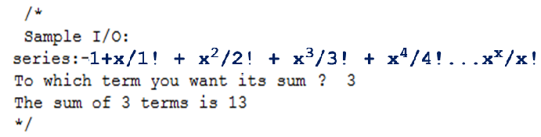
Taylor’s series
Program
Additional Information

Slide 24
Newton’s forward differences
Implement a C++ program to demonstrate functionality of Newton’s forward difference method for the following records, with x=2.35
Program
Additional Information
x | 2 | 2.25 | 2.5 | 2.75 | 3
f(x) | 9 | 10.06 | 11.25 | 12.56 | 14

Slide 25
Newton’s forward differences
Pseudo code for Newton’s forward differences
Input n //how many records you will enter
for i=0 to n in step 1
Begin
Print “enter the value of x[i] "
Input x[i]
Print "enter the value of f(x[i]) "
Input y[k][i];
end
Program
Additional Information

Slide 26
Newton’s forward differences
Print “Enter X for finding f(x): “
Input p
For i=1 to n in step 1
Begin
for j=0 to n-i in step 1
begin
y[i][j]←y[i-1][j+1]-y[i-1][j]
end
End
Program
Additional Information

Slide 27
Newton’s forward differences
For i=0 to n in step 1
begin
Print “\n” , Print x[i]
for j=0 to n-i in step 1
begin
Print " “, y[j][i]
end
Print "\n"
end
Program
Additional Information

Slide 28
Newton’s forward differences
Initialize i=0
do
begin
if(x[i]<p and p<x[i+1])
k←1
else
increment i
end while(k != 1)
Program
Additional Information
f←i
u ←(p-x[f])/(x[f+1]-x[f])
Print u
n ← n-i+1
sum ← 0

Slide 29
Newton’s forward differences
For i=0 to n-1 in step 1
begin
temp ← 1
for j=0 to i in step 1
begin
temp ← temp * (u - j)
end
m ← fact(i) // write a fn to calculate
factorial
sum ← sum + temp*(y[i][f]/m)
end
Print sum
Program
Additional Information
Notes:
29
29

Slide 30
Newton’s forward differences
Output:
how many records you will enter: 5
enter the value of x0: 2
enter the value of f(x0): 9
enter the value of x1: 2.25
enter the value of f(x1): 10.06
enter the value of x2: 2.5
enter the value of f(x2): 11.25
enter the value of x3: 2.75
enter the value of f(x3): 12.56
enter the value of x4: 3
enter the value of f(x4): 14
Enter X for finding f(x): 2.35
Program
Additional Information
Notes:
30
30

Slide 31
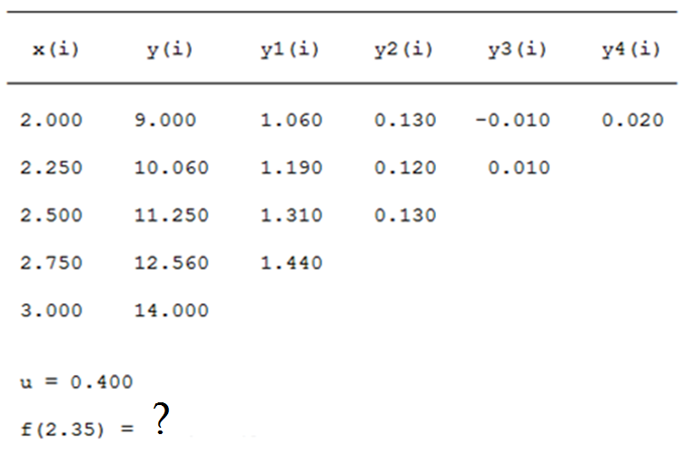
Newton’s forward differences
Program
Additional Information

Slide 32
Newton-Raphson method
Implement a C++ program to obtain the roots of the polynomial 1x³ - 0x² - 1x¹ -3x⁰, with maximum power of 3, having initial value x1=3 using Newton Raphson’s method.
Program
Additional Information

Slide 33
Newton-Raphson method
Pseudo code for Newton-Raphson method
Input user_power// enter the total no. of power
for i=0 to user_power in step 1
begin
input coef[i]
end
for i=user_power to 0 in step -1//printing coeff
begin
print " “,coef[i],"x^“,I," ";
end
Program
Additional Information
Input x1;
Print ITERATION X1 FX1 F'X1

Slide 34
Newton-Raphson method
do
begin
cnt++
fx1=fdx1=0;
for(i=user_power to 1 in step -1
begin
fx1←fx1+coef[i] * (pow(x1,i))
end
fx1 ← fx1 +coef[0];
for i=user_power to 0 in step -1
begin
fdx1 ← fdx1 +coef[i]* (i*pow(x1,(i-1)))
end
Program
Additional Information

Slide 35
Newton-Raphson method
t ← x2;
x2 ←(x1-(fx1/fdx1));
x1 ← x2;
Print cnt, " " ,x2," ",fx1," ",fdx1," ".
end while((fabs(t - x1))>=0.0001);
Print “ THE ROOT OF EQUATION IS “, x2
Program
Additional Information

Slide 36
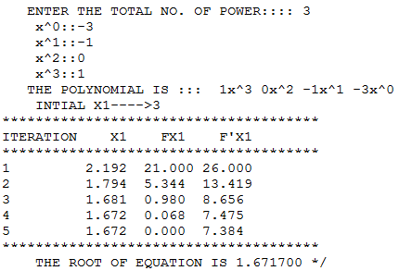
Newton-Raphson method
Output:
Program
Additional Information

Slide 37
Summary
Parameter passing techniques
pass by value
void swap(int x, int y )
pass by reference
void swap(int *x, int *y )
Passing 1 D array
int fnParr( int a[ ], int n)
Passing 2 D array
int fn2d( int x[ ][10], int m, int n)

